Slide 1
Architecture and Components of CRM
1

Slide 2
Learning Objectives
Understand the customer relationship process.
Know the evolution, current status, and categories of the customer relationship management (CRM) system.
Understand the components and architecture of CRM systems.
Examine the CRM life cycle and its relationship with other enterprise software.
Examine the impact of CRM on an organization.

Slide 3
Preview
A good strategy coupled with a well-defined set of requirements, identification of key success factors, and good partnerships will usually lead to success in CRM technology.
It is important for the company to understand that CRM implementation needs to be customer driven more than technology driven.
CRM implementation must involve people, process, and systems, rather than just a narrowly defined IT application.

Slide 4
What Is CRM?
A true CRM integrates corporate strategy, business methodology, and technology to accomplish a myriad of goals for companies that want to operate in a customer-driven environment.
No business can survive without understanding its customers and having a positive relationship with them.
CRM provides support for the front-end customer facing functionality (e.g., marketing, sales, and customer service), which are usually not available in traditional ERP systems.

Slide 5
CRM Evolution
In the 1980s through the mid-1990s companies started using IT to automate customer processes with discrete customer-centric applications.
Late 1990s, companies started integrating these discrete systems into what is now known as CRM.
CRM began in response to a changing market environment as mass marketing gave way to focused segment marketing, and finally to target marketing an individual.
Enabled by new technologies that collected consumer data, companies progressed to focused segment marketing.

Slide 6
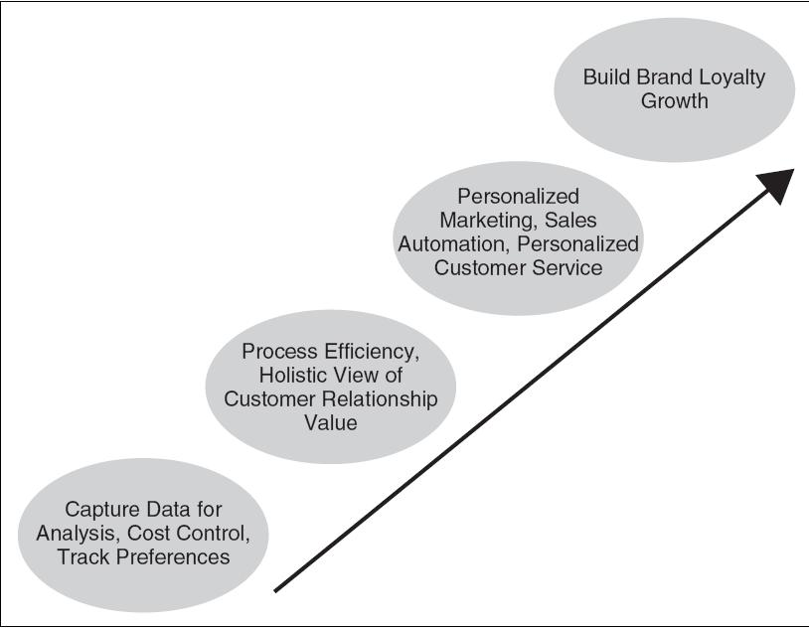
Evolution of CRM Programs

Slide 7
CRM Today
Globalization and ubiquitous connectivity are forcing companies to re-evaluate how to deliver value to customers.
Large and small companies now deliver similar products at low cost with an abundance of options for customers mainly due to globalization.
To be successful in this competitive environment, companies have to deliver both quality products and unique and dynamic experiences for the customer depending on his/her needs.

Slide 8
Types of CRM
Operational CRM
  Provide front- and back-end support for sales and marketing, administrative personnel, or customer-service processes.
Analytical CRM
  Provide tools for collection and analysis of data gathered during the operational process to help create a better relationship and experience with clients or end-users.
Collaborative CRM
  Deal with the interaction points between the organization and the customer.

Slide 9
Business Strategy Perspective of CRM
Business | Promotes customer-centric approach Customer segmenting One-on-one marketing Increase customer retention
Technology | Foster close customer relationship Analyze customer information Coherent view of customer
Customer | Increased interaction opportunity Increase customer loyalty Better “word-of-mouth” advertising

Slide 10
Customer Relationship Processes
A good CRM should provide support for the following functions.
  Capture and maintain customer needs, motivations, and behaviors over the lifetime of the relationship.
  Facilitate the use of customer experiences for continuous improvement of this relationship.
  Integrate marketing, sales, and customer support activities measuring and evaluating the process of knowledge acquisition and sharing.

Slide 11
CRM Delivery Processes
Campaign Management
  To generate “leads” or potential clients for the organization.
Sales Management
  To convert the lead generated by campaign management into a potential customer.
Service Management
  Provide ongoing support for the client and to assist in the operation of the product or service purchase.
Complaint Management
  To improve customer satisfaction by directly addressing the complaint of the customer and supporting a continuous improvement process.

Slide 12
CRM Support Process
Market Research
  Focuses on systematic design, collection, analysis, and reporting of data, and on findings relevant to specific sales activity in an organization.
  Involves integration of external and internal data from a wide variety of sources.
Loyalty Management
  Provides the processes to optimize the duration and intensity of relationships with customers.

Slide 13
CRM Analysis Processes
Lead Management
  Focus is on organizing and prioritizing contacts with the prospective customers.
Customer Profiling
  Focus is to develop a marketing profile of every customer by observing his or her buying patterns, demographics, buying and communication preferences, and other information that allows categorization of the customer.
Feedback Management
  Consolidates, analyzes, and shares the customer information collected by CRM delivery and support processes with the analysis process and vice versa.

Slide 14
CRM Technology
CRM technology implements a companywide business strategy in an effort to reduce costs and enhance service by solidifying customer loyalty.
With the rise of the Internet, data mining and analytics techniques have advanced to where they can be considered an integral component of CRM.
True CRM brings together information from all data sources within an organization to give one, holistic view of each customer in real time.

Slide 15
CRM Components
Market Research
  The two key functionalities here are campaign management and market analysis.
    Campaign management provides support for preparing such things as marketing budgets, ad placement, sales targeting, and response management.
    Marketing analysis tools provide statistical and demographic analysis.
Sales Force Automation (SFA)
  Provide basic functionality for sales personnel to automate sales lead distribution and tracking etc.

Slide 16
CRM Components (Cont’d)
Customer Service Support
  Typically includes help desk ticket management software, e-mail, and other interaction tools connected to a fully integrated customer database, which is connected to the SCM and ERP application.
Data Mining and Analytics
  Data must be collected, sorted, organized, and analyzed for trends, demographics, cross-selling opportunities, and identification of other sales patterns.

Slide 17
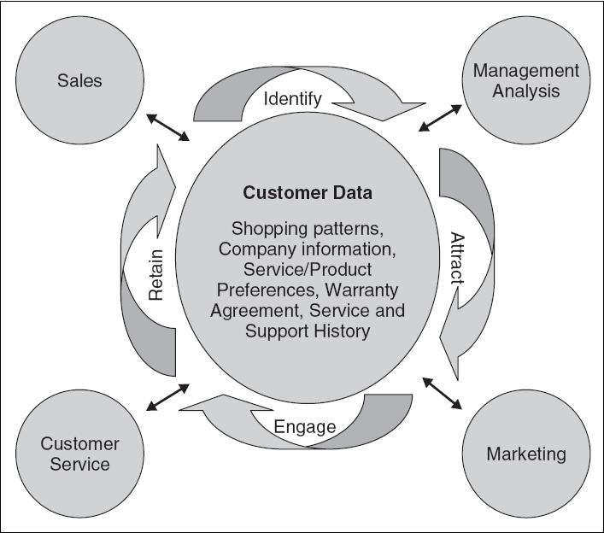
CRM Components

Slide 18
CRM Packages and Vendors
Big CRM vendors provide more features than the smaller vendors do, but there is no software package that can work directly off-the-shelf.
Target Market | Vendor
Large Enterprises | Siebel, Vantive, Clarify, and Oracle
Midsize Firms | Servicesoft, Onyx, Pivotal, Remedy, and Applix
Small Companies | Goldmine, Multiactive, and SalesLogix
On-Demand CRM
  Provides firms with the option of a scalable CRM application suite via a browser, and pay a per-month, per-user set fee.

Slide 19
CRM Architecture
Typical CRM systems follow client – server architecture. The system environment consists of the following components:
  Application server: Runs either front-end processing or querying data and possibly a Web interface for the CRM system.
  Database server: Houses the back-end database and possibly retrieves information from other database systems in the company to present through the application server.
  Web server: Used if the CRM provides an extranet access point for such external users as vendors or customers and an intranet access point for employees.

Slide 20
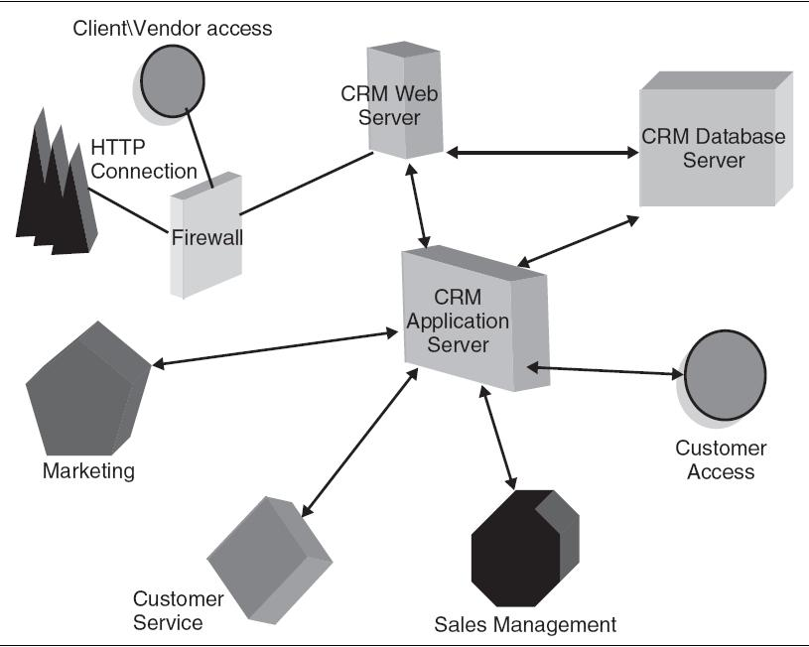
CRM Architecture

Slide 21
On-Demand CRM
High-speed secure Internet connectivity has recently spurred a lot of interest and demand in hosted CRM systems.
Using thin-client architecture, such vendors as NetSuite, Inc. and Salesforce.com have provided firms with the option of a scalable CRM application suite via a browser and pay a per-month, per-user set fee
Other on-demand CRM vendors include Siebel, RightNow, Microsoft, and Oracle
Small businesses are slowly shifting to on-demand software due to high costs of installation, maintenance, and security

Slide 22
CRM Life Cycle
A CRM system life cycle involves focus on people, procedures, company philosophy, and culture, rather than just information technology.
Adequately outline the corporate CRM goals and the practical process changes that have to occur before focusing on possible technology solutions.
Functional requirements must be considered before making a decision on the architecture.
There are many CRM products from which to choose, depending upon the complexity of the information needed and the resources to manage the program.

Slide 23
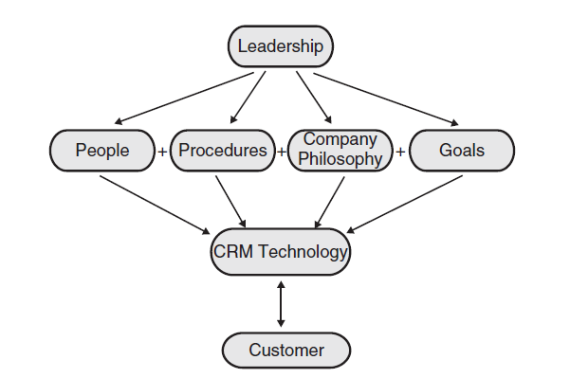
CRM Life Cycle

Slide 24
Implications for Management
CRM is a strategic business solution and not a technical solution.
CRM should not be implemented as a single system or at one time.
CRM systems come in a variety of shapes and sizes, but there is no real off-the-shelf solution.
Even though CRM provides a great solution for one-on-one individualized marketing, it also provides good mechanisms for privacy and ethical violations.

Slide 25
Summary
Customer relationship management (CRM) systems are an integral part of enterprise systems for today’s global market where many organizations are competing for the same customers.
No business can survive in a competitive environment without keeping a customer happy.
CRM systems can be categorized by functionality, business strategy, and implementation perspectives.
The customer relationship process is complex and integrates several functional areas of the organization.

Slide 26
Summary (Cont’d)
A CRM system combines a wide variety of computer and communication technology.
The major components of the CRM system are market research tools, sales force automation software, customer service and support tools, and data mining and analytics.
CRM solutions exist in hosted and installed environments.
CRM implementation must never focus on a technology solution.

Slide 27
Review Questions
Why is it necessary for an organization to have a good customer relationship management (CRM) system?
Define the role of CRM in your own words.
What are the key differences between today’s CRM and the early generation of CRMs?
How does CRM impact the company’s bottom line or performance?
What are the major types of CRM?
Briefly describe the customer relationship processes.
What are the major components of CRM?

